Slide 1
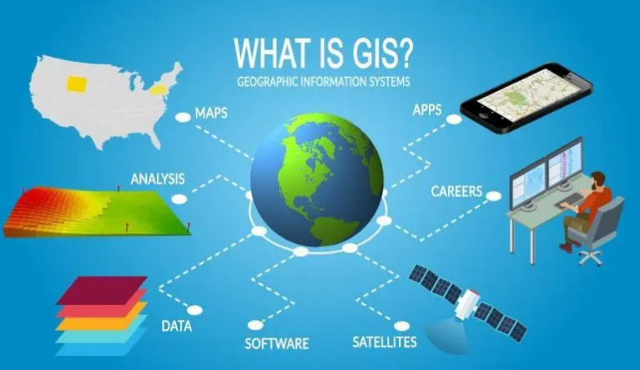
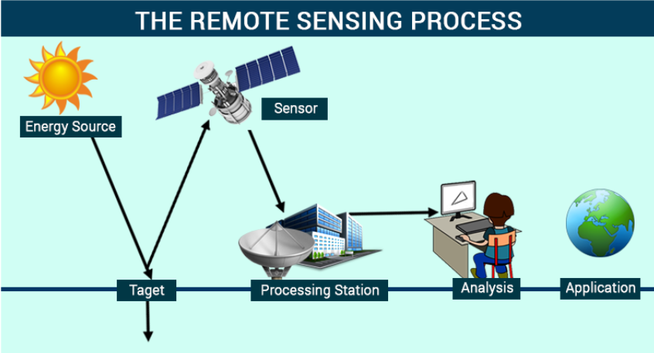
GIS is a technological field that incorporates geographical features with tabular data in order to map, analyze, and assess real-world problems.
Remote sensing is the process of detecting and monitoring the physical characteristics of an area by measuring its reflected and emitted radiation at a distance (typically from satellite or aircraft). Remote sensed imagery is integrated within a GIS

Slide 2
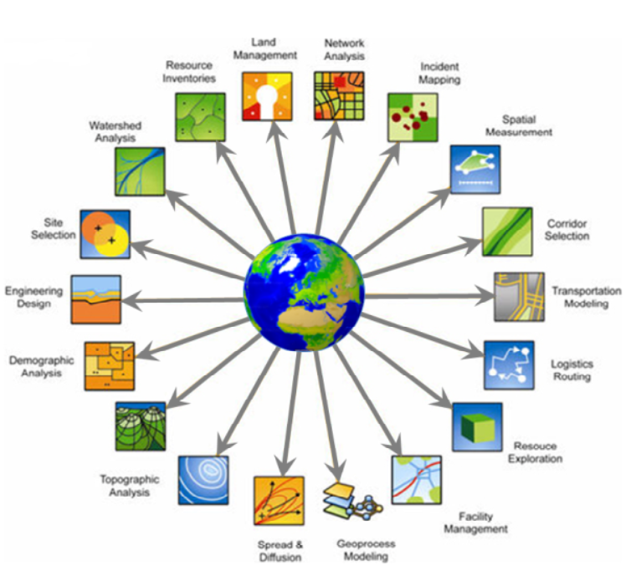
Application of GIS
Urban Planning
Rural Planning
Water
Land Management
Disaster Management
Utility Mapping
Navigation etc.

Slide 3
Application of GIS in Water Sector Why ? Using GIS through RS. RS :
Allows rapid assessment of large areas, and selection of subsets for detailed analyses
Water has distinctive spectral properties; water absorbs radiation – in infrared imagery, water appears black
Water quality can also be picked up from remote sensing.

Slide 4
Application of GIS in Hydrology GIS Input for :
River Basin Planning/ Modelling
Command Area Management
Storm Water Management Plan
Flood Inundation Study
Rainwater Harvesting and Artificial Recharge
Flood Forecasting
Disaster Early Warning
Watershed Management
Groundwater Assessment
Water Quality Assessment

Slide 5
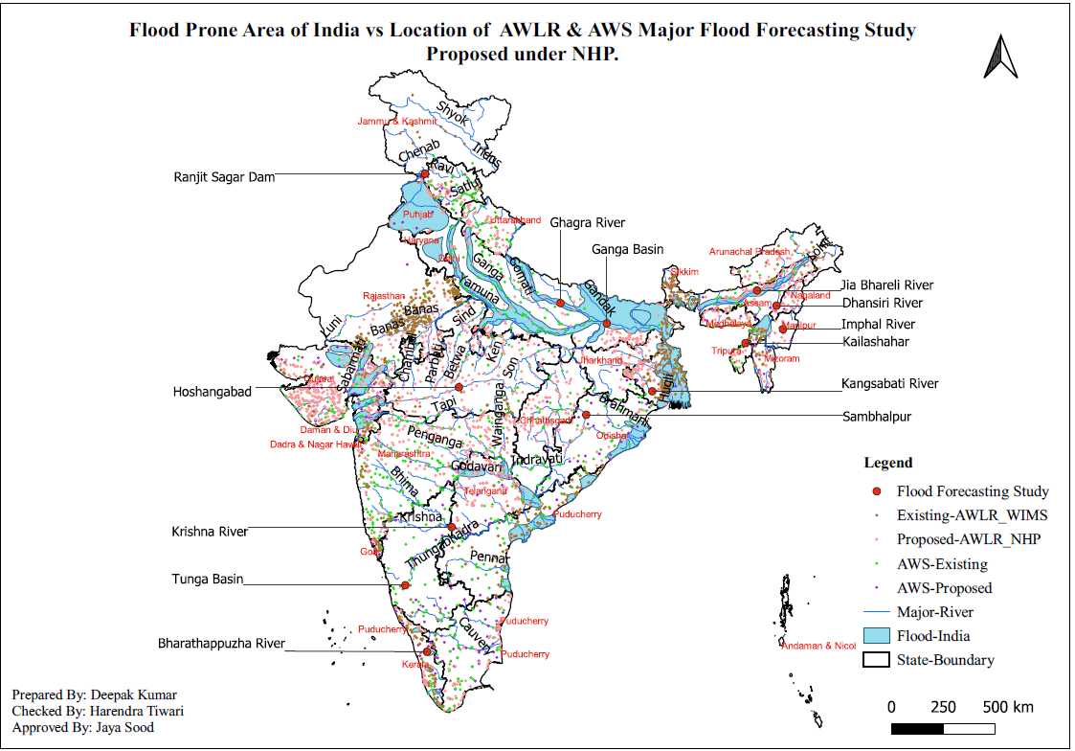
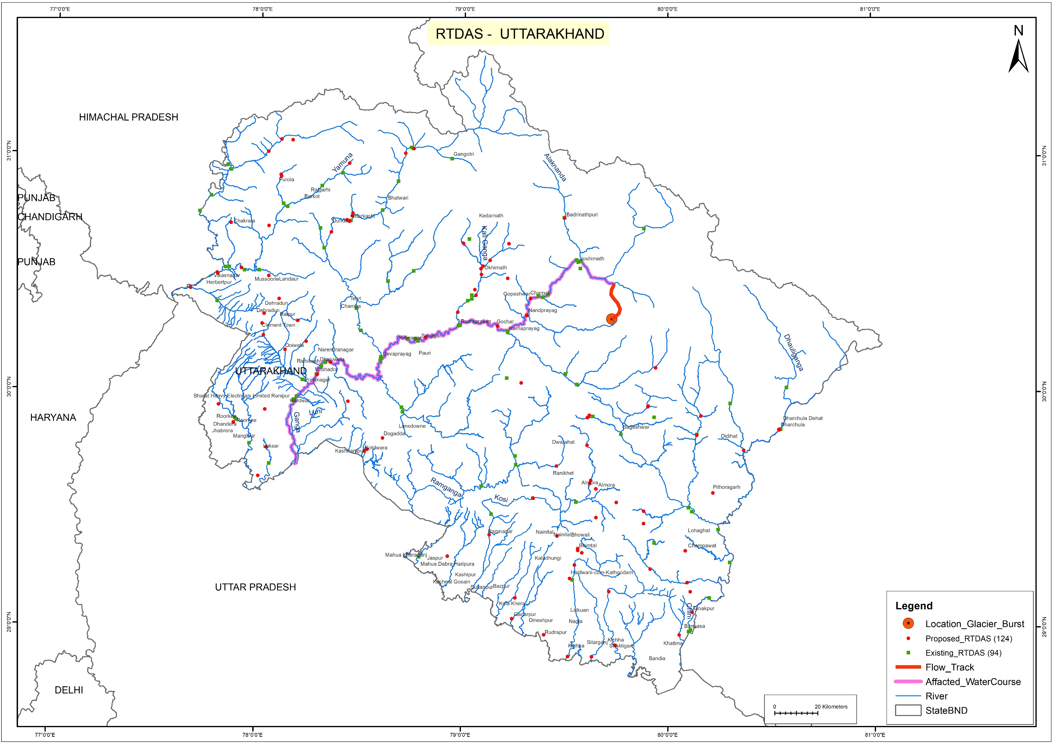
Mapping of Features for Planning through GIS

Slide 6
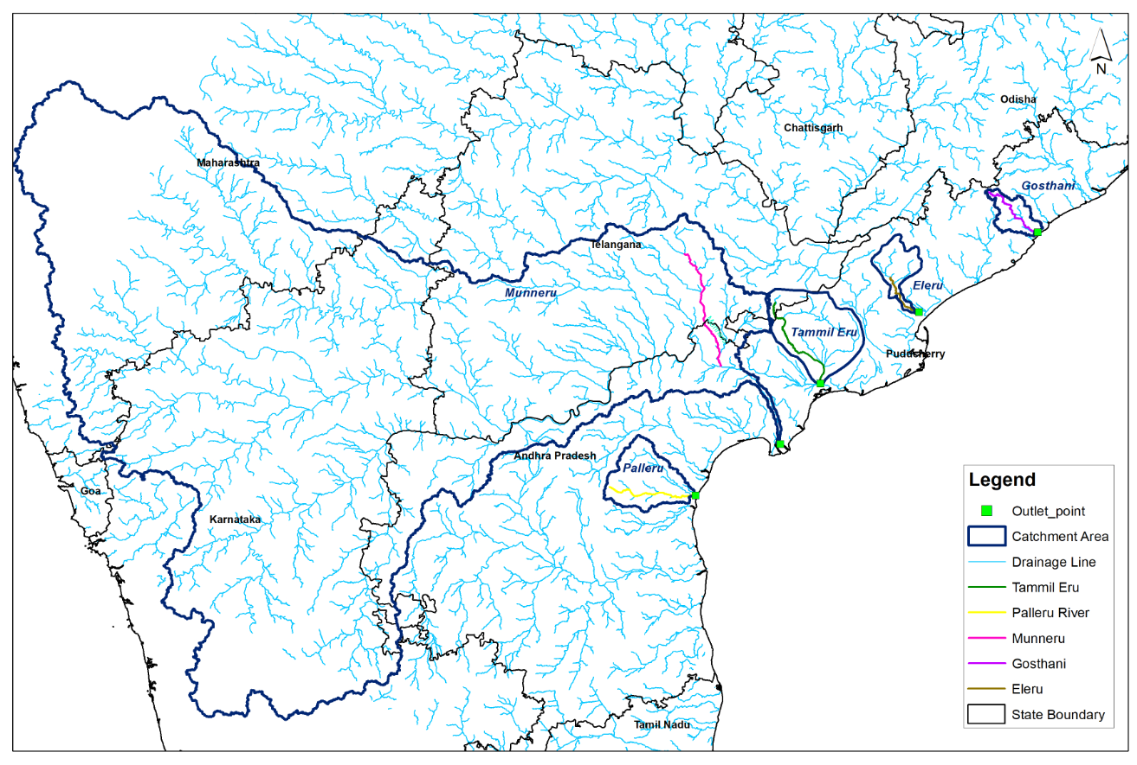
Application of GIS in Hydrology
Catchment Delineation
Extraction of Streams
Delineation of surface water bodies

Slide 7
Major GIS Input used in Hydrolgy :
Basin & Sub basin (delineated from DEM), Streams, (captured through images or delineated from DEM)
• Land-use/Land-cover Data
• Rainfall (spatial distribution through radar satellites)
• Soil moisture and its spatial distribution for estimation of crop water use and irrigation requirement
• Reservoir water spread through multi-temporal images
• Spread of habitation in village/ urban sprawl over time (to assess growth of domestic and municipal water demand over the past and prepare estimates for the future)
• Spread of industrial area to corroborate with information on growth pattern of industries, for better estimation of future industrial water demand
• Estimation of snow water melt (through spatial coverage of snow bound area and temperature)

Slide 8
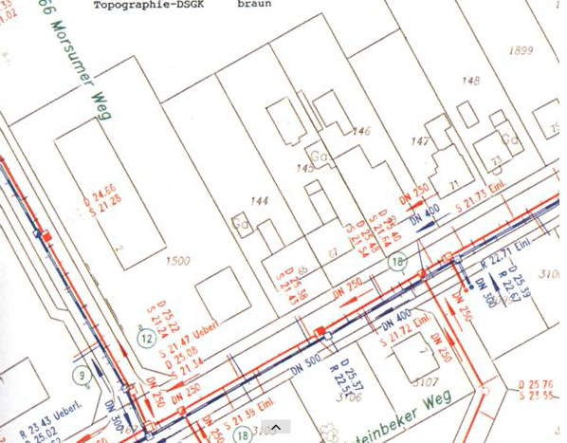
Application of GIS in Water Utility
Water Supply Design
Sewerage Design
Drainage Design
FOR:
Development of hydraulic models,
Creation of thematic maps of the model output results,
Network simplification (skeletonization) for hydraulic modeling,
Estimation of node demands, estimation of node elevations

Slide 9
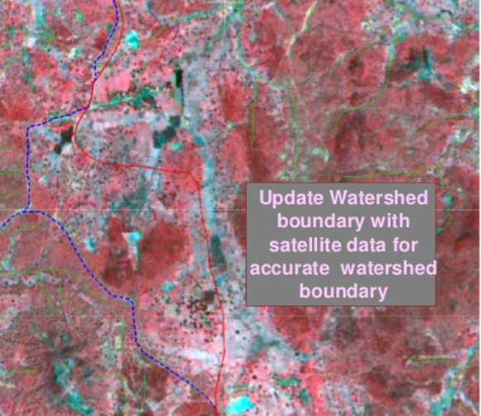
Application of GIS in Watershed Management
Terrain Modelling
Creation of DEMs,
Automated watershed extraction
from topography,
Flow determination – direction and
accumulation ,
Stream-ordering

Slide 10
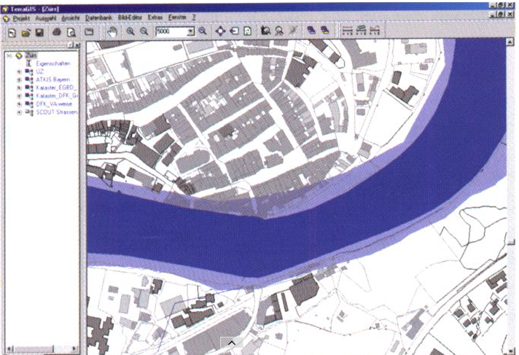
Application of GIS in Flood Management For * Flood plain delineation * Channel characteristics * Inundation modeling * Infrastructure analysis * Risk modeling and mitigation

Slide 11
Application GIS in Groundwater Assessment:
Remote sensing can be used to collect information about terrain geology and geomorphology, crucial for estimation of groundwater potential
Lineaments, cracks and fissures and their crossings that are extremely useful for locating wells in hard rock terrain are seldom visible on ground but easily demarcated on satellite images

Slide 12
Application of GIS in Irrigation Command Area management
Estimation of crop acreage
Crop production
preparation of “irrigability maps” through land use planning.

Slide 13
Application GIS in Quality analysis of water :
Satellite imageries have been used successfully in determination of various water quality parameters like Total Suspended Solids, turbidity, chlorophyll content, colour, temperature etc. By Remote Sensing
Use of GPS for location & photographic tiepoints

Slide 14
The latest RS technologies applied in Water Sector include:
3D surface model analysis
Unmanned aerial vehicle (UAV) video image classification
Ground penetration radar for soil moisture estimation
The Tropical Rainfall Measuring Mission (TRMM) and the Global Precipitation Measurement (GPM) satellite rainfall measurements
Storm hyetography analysis
Rainfall runoff and urban flooding simulation
Satellite radar and optical image classification for urban water bodies and flooding inundation.
The application of those technologies is expected to greatly relieve the pressures on water resources and allow better mitigation of and adaptation to the disastrous impact of droughts and flooding.

Slide 15
Thank You !

